Slide 1
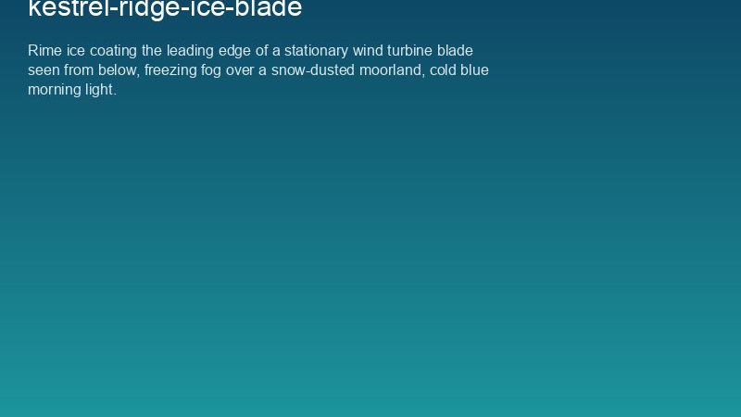
WEYLAND ENERGY
Ice season and winter driving
Onshore wind farms · October to April

Slide 2
Ice throw and ice fall
• Hazard zone 342 m around running turbines (Kestrel Ridge)
• Ice fall zone 117 m around stopped turbines
• Park outside the zone, approach upwind
WEYLAND ENERGY · Toolbox Talk – Ice Season and Winter Driving
2

Slide 3
Restart rules
• Automatic restart only after 3 h above +2 °C
• Manual restart only after visual check in daylight
• Never restart in fog without camera check
WEYLAND ENERGY · Toolbox Talk – Ice Season and Winter Driving
3

Slide 4
Winter driving on site tracks
• Winter tyres on all site vehicles from 1 November
• Max. 20 mph on tracks
• Snow chains and shovel in every vehicle
• Check-in call before leaving the public road
WEYLAND ENERGY · Toolbox Talk – Ice Season and Winter Driving
4

Slide 5
Last winter in numbers
27
0
6
Turbine-days with ice stops
Ice-related incidents
Manual restarts
WEYLAND ENERGY · Toolbox Talk – Ice Season and Winter Driving
5

Slide 6
WEYLAND ENERGY
Stay warm, stay safe
Questions to your site manager

